Slide 1
DESIGN OF A REAL TIME HAND TO TEXT SIGN LANGUAGE RECOGNITION SYSTEM
Sankalp Bisan, S. K. Atre and S. J. Sharma,
Department of Electronics and Computer Science,
Rashtrasant Tukadoji Maharaj Nagpur University, Nagpur

Slide 2
Contents
Introduction
Significance of the Present Work
System Description
Experimental Setup
Results
Conclusion

Slide 3
Introduction
Communication is a key to exchange our thoughts and information
The deaf-dumb people can not communicate verbally as we all do
Their only mode of communication is sign language
Sign language to system is very helpful for deaf-dumb people
It bridges the communication gap among verbally and nonverbally communicating people

Slide 4
Significance of the Present Work
Establishing communication with verbal communicators
Grabbing opportunities for deaf and dumb persons
Enhancing their Expressiveness and inclusiveness in the main stream

Slide 5
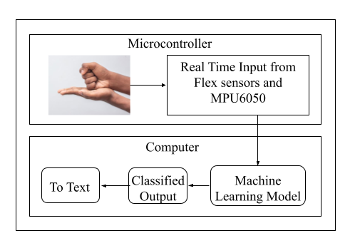
System Description
Fig. 1: Block Diagram of the System

Slide 6
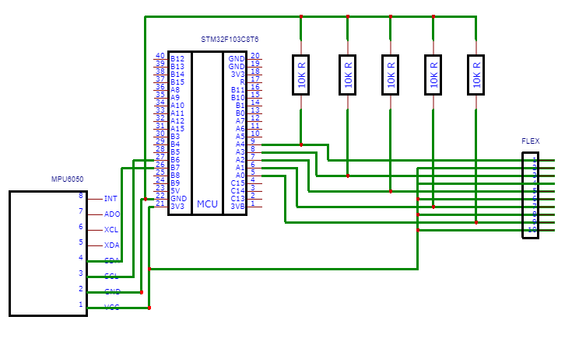
Fig. 2: Circuit Diagram of the System

Slide 7
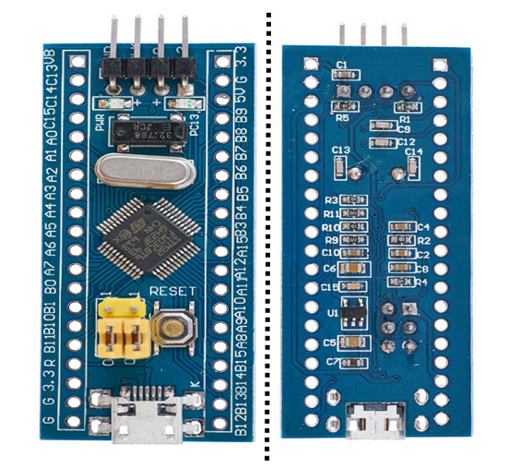
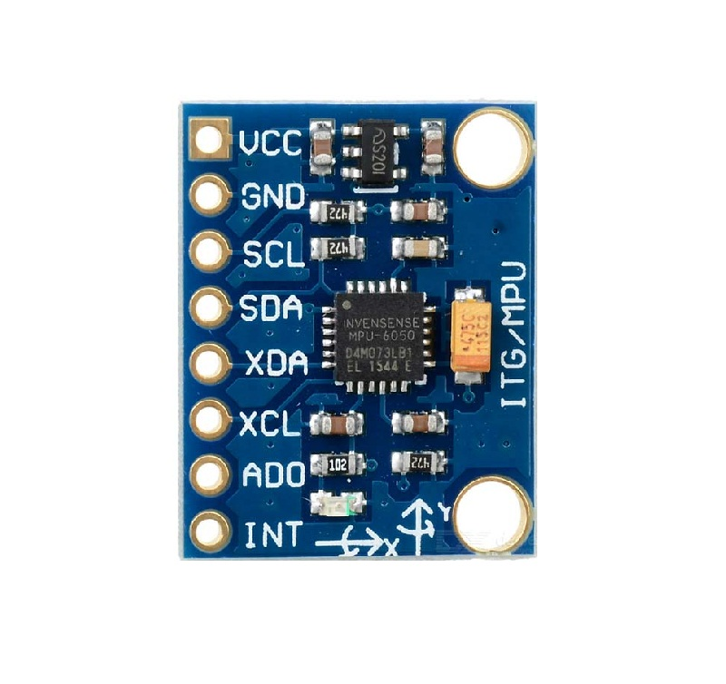
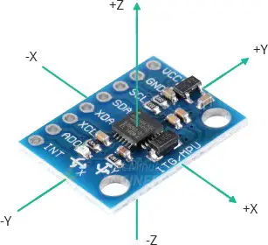
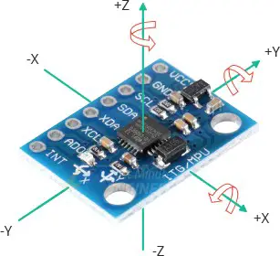
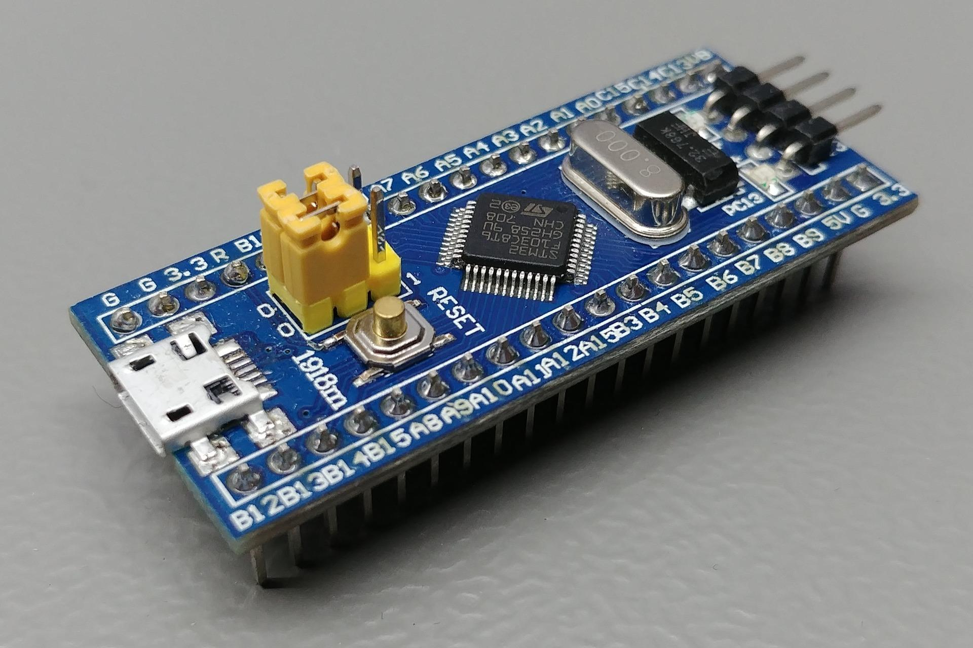
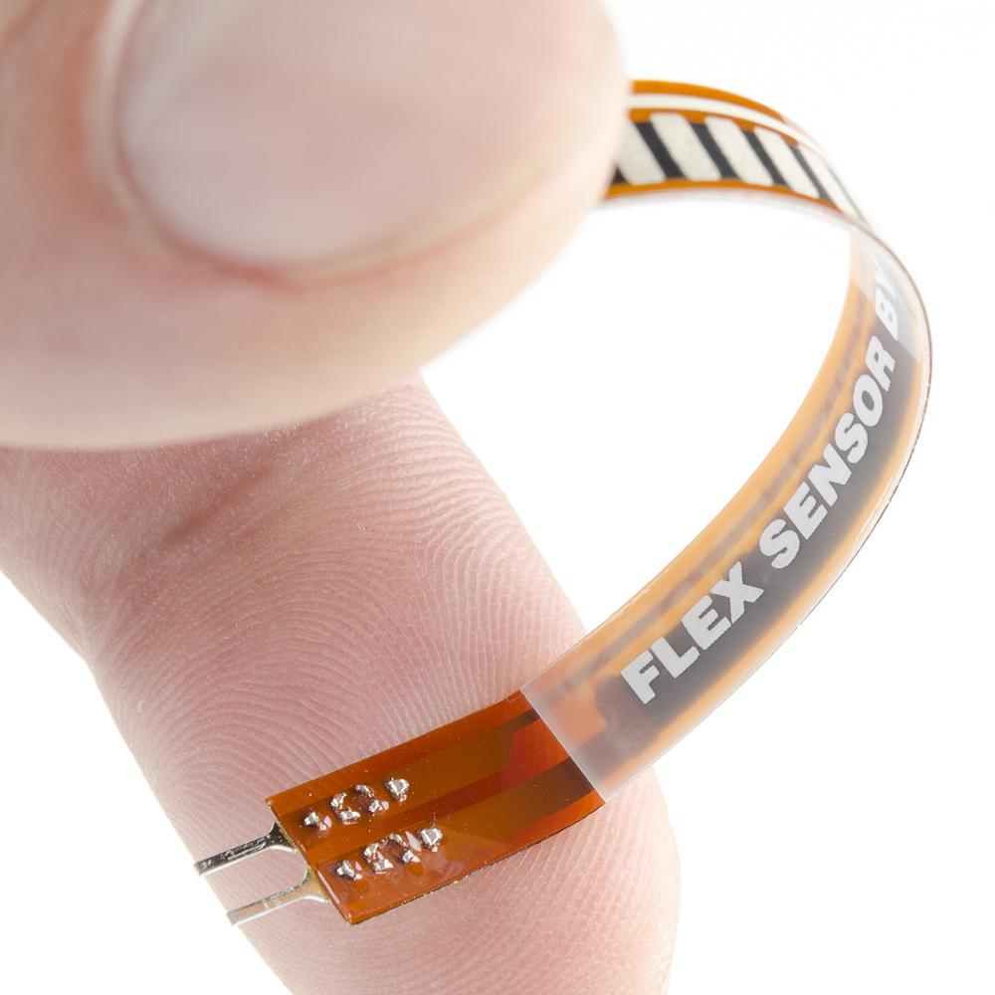
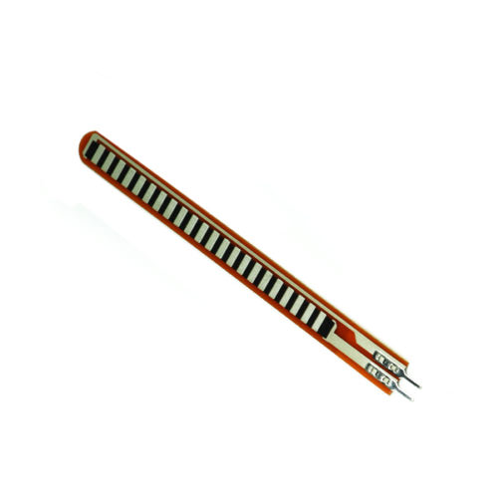
Fig. 4: MPU6050
Fig. 3: Microcontroller STM32F103C8T6
Fig. 5: Flex Sensor

Slide 8
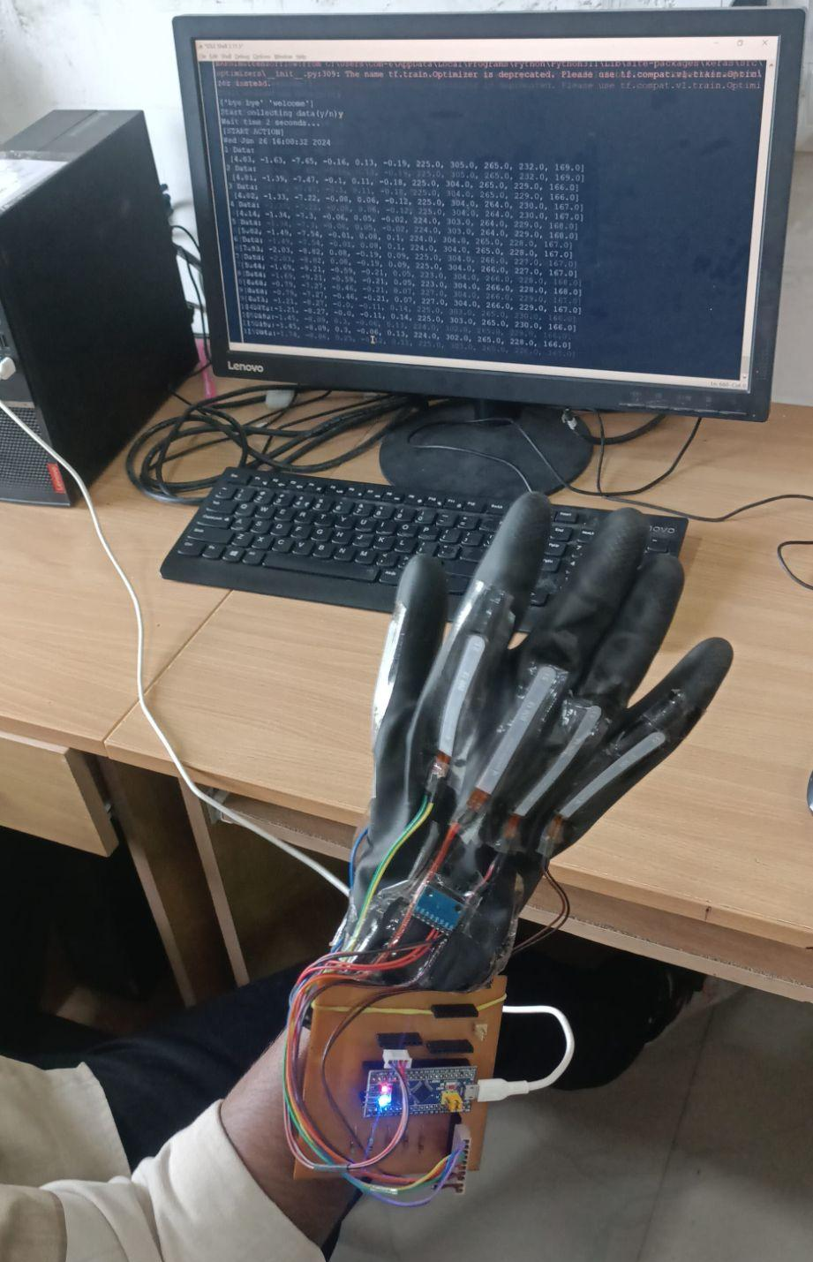
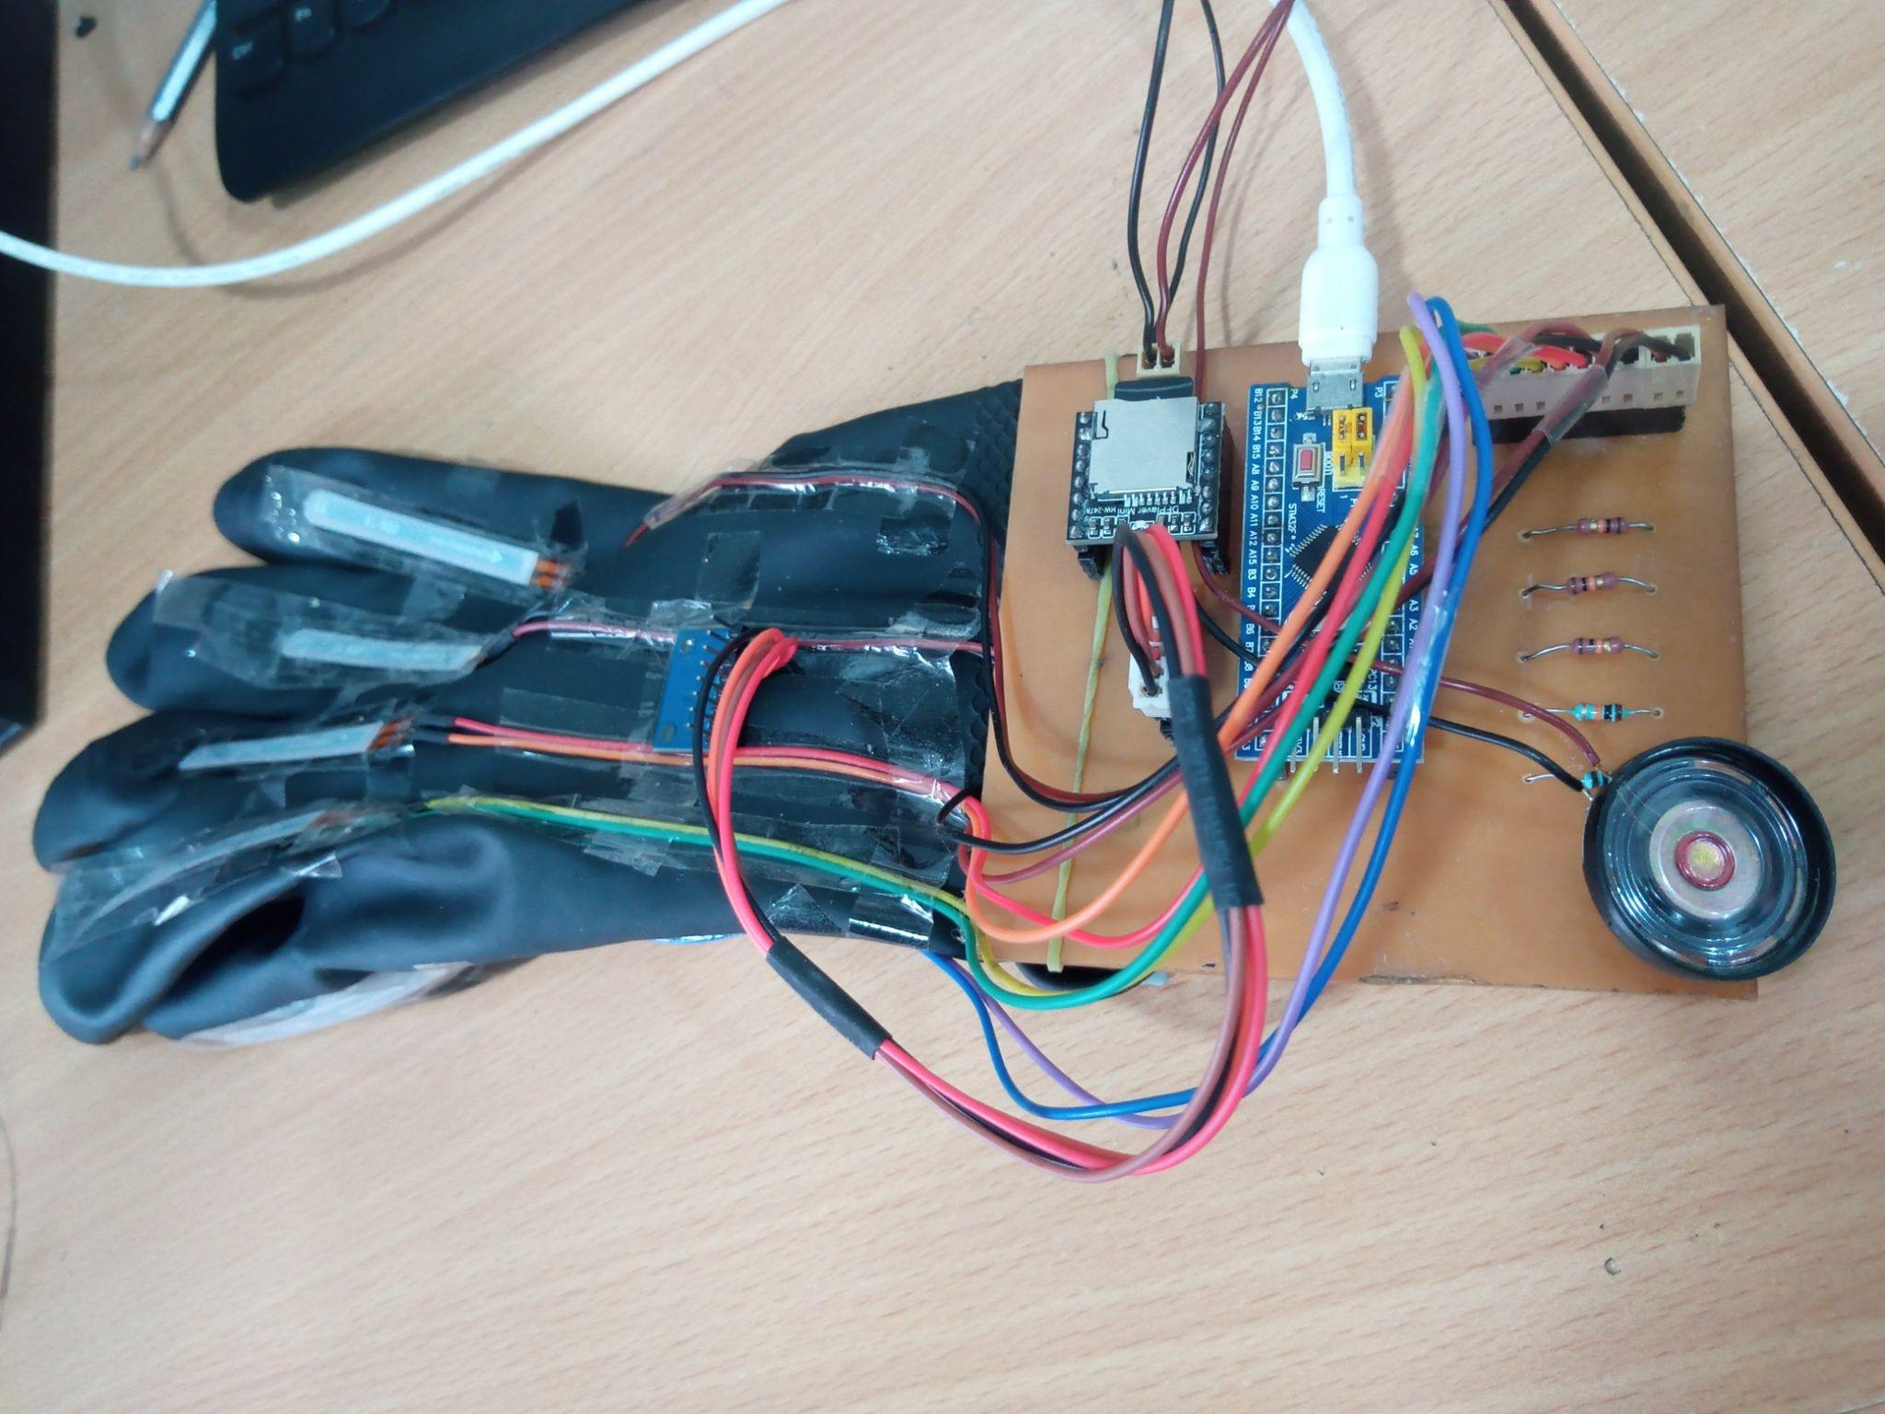
Experimental Setup
Hardware Setup
Fig. 6: Wearable Glove used in the Present Work
Fig. 7: Complete Setup of the System

Slide 9
2. Input
The input to the system: Hand gestures performed in real time
3. Dataset
We have generated our own dataset for only two signs for testing the designed system
Contains 2 commonly used signs (“WELCOME” & “BYE-BYE”) in Indian Sign language, each sign having 30 samples.
Every reading consists of 11 values, 6 of which are obtained from the IMU module, which includes x, y and z axis readings of accelerometer and gyroscope and the other 5 readings are obtained from the 5 flex sensors attached to the fingers of the glove.
Each sample consists of 50 rows representing 50 time points, making a 2D sample of 50 rows & 11 columns.

Slide 10
4. Algorithm
Long Short-Term Memory (LSTM)
LSTMs are particularly adept at analyzing sequential data, where information unfolds over time like sensor readings, text, or speech
Long Short-Term Memory networks, are a special kind of RNN designed to address a major limitation of RNNs
It can learn long-term dependencies within sequences, overcoming the vanishing gradient problem
LSTM Architecture of one unit:
The LSTM architecture consists of one unit, the memory unit and each unit is made up of four feedforward neural networks.
Each of these neural networks consists of an input layer and an output layer.
In each of these neural networks, input neurons are connected to all output neurons.
As a result, the LSTM unit has four fully connected layers.

Slide 11
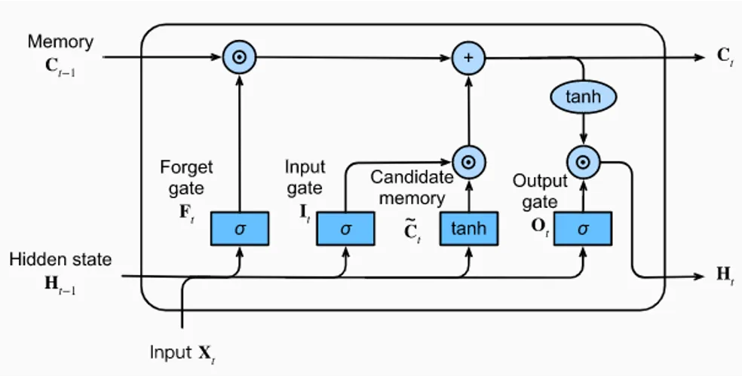
Fig. 8: LSTM Architecture

Slide 12
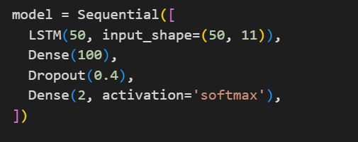
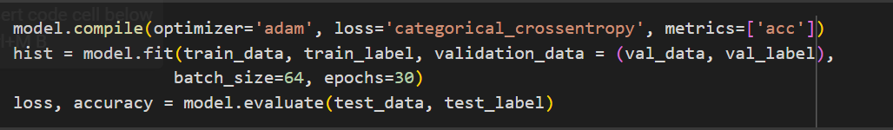
Training Model using LSTM algorithm
Fig. 9: Training Model

Slide 13
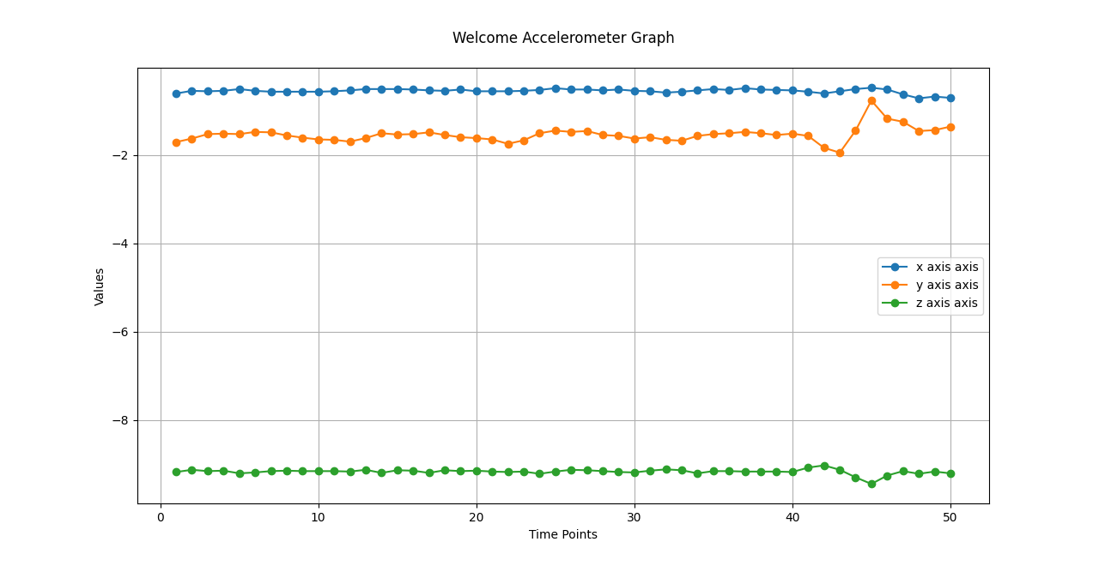
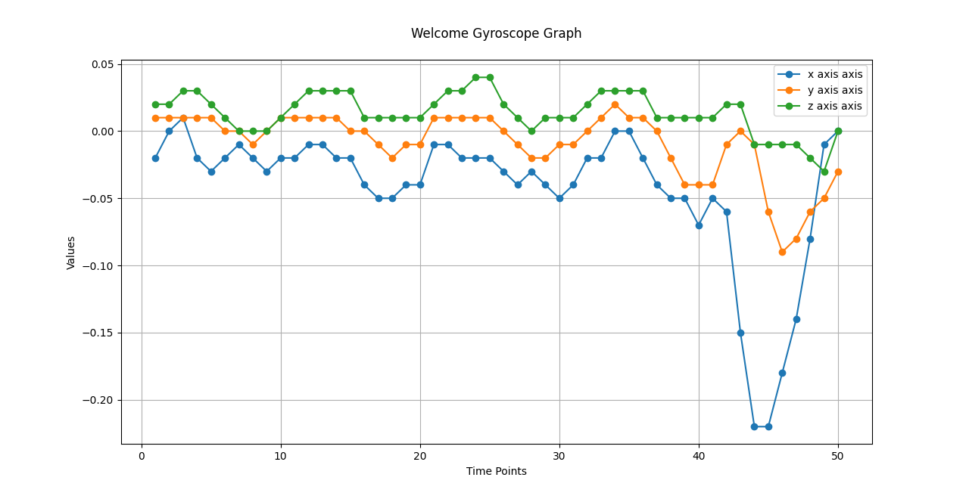
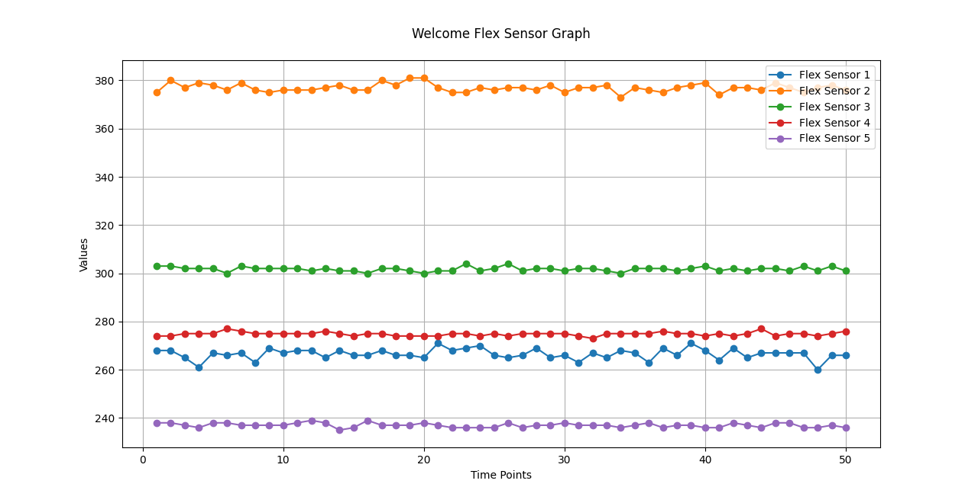
Results
Measurement data obtained at Various Sensors for “WELCOME” Gesture

Slide 14
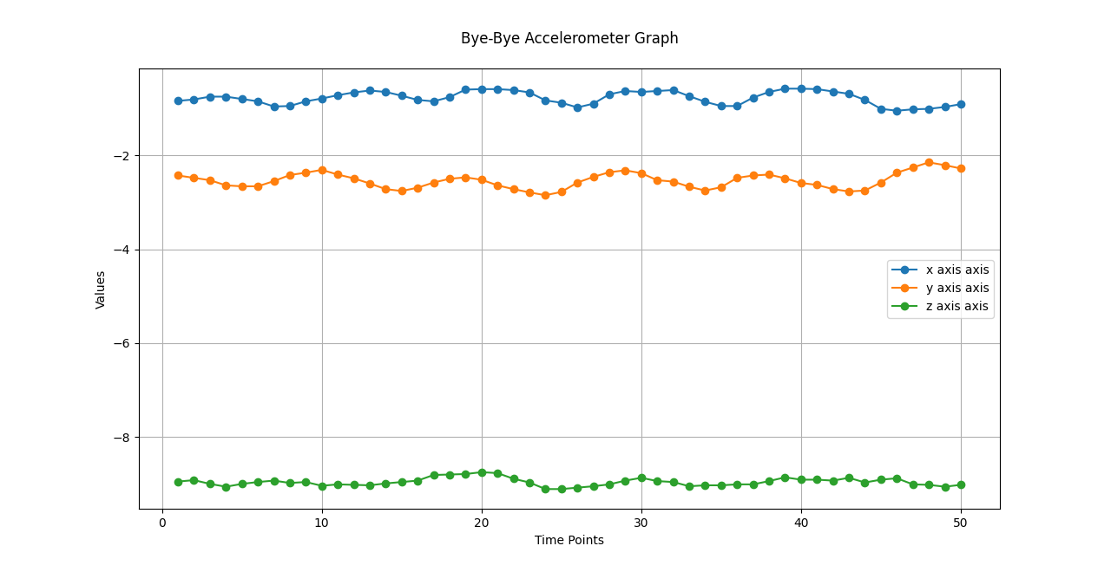
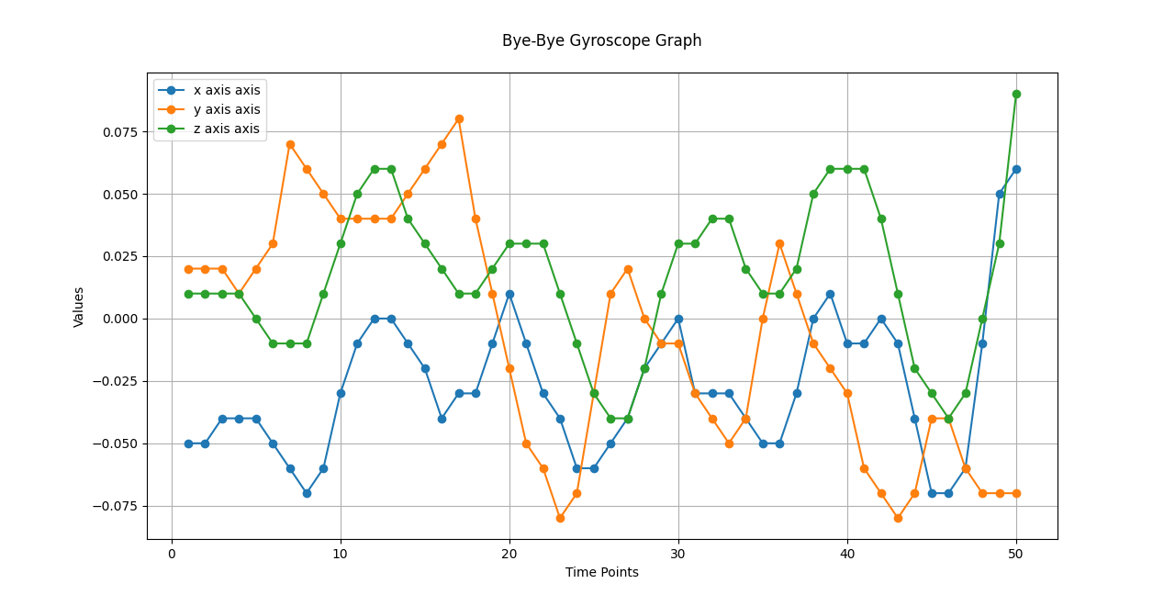
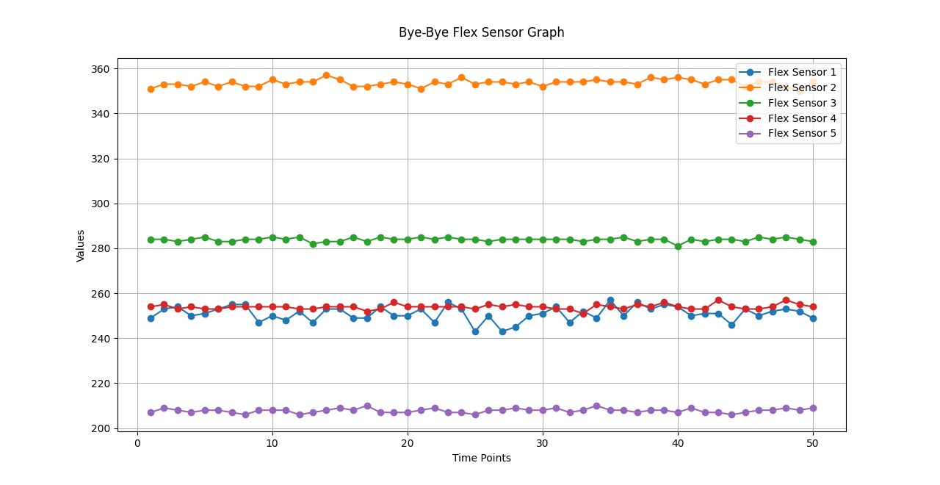
Measurement data obtained at Various Sensors for “BYE-BYE” Gesture

Slide 15
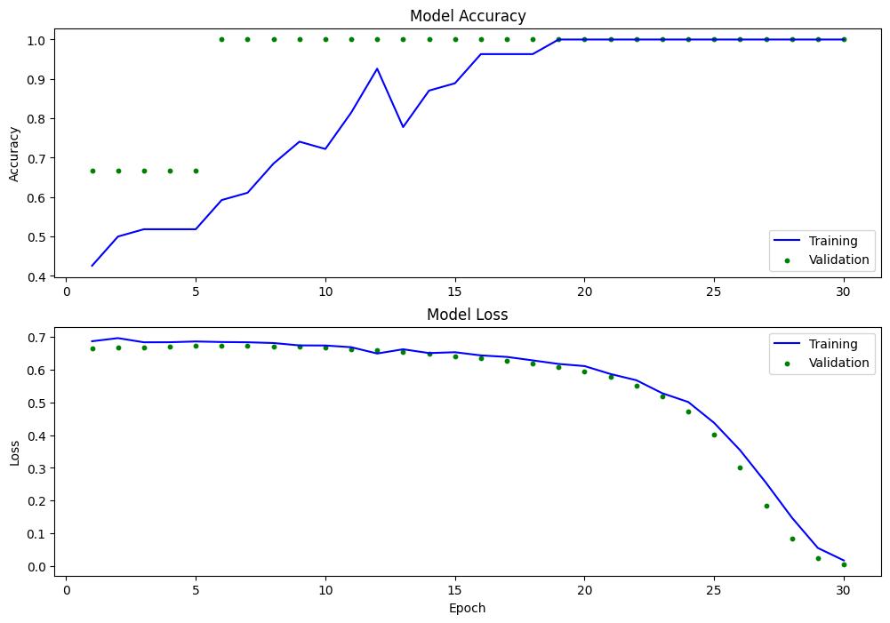
Accuracy and Loss while Training Model

Slide 16
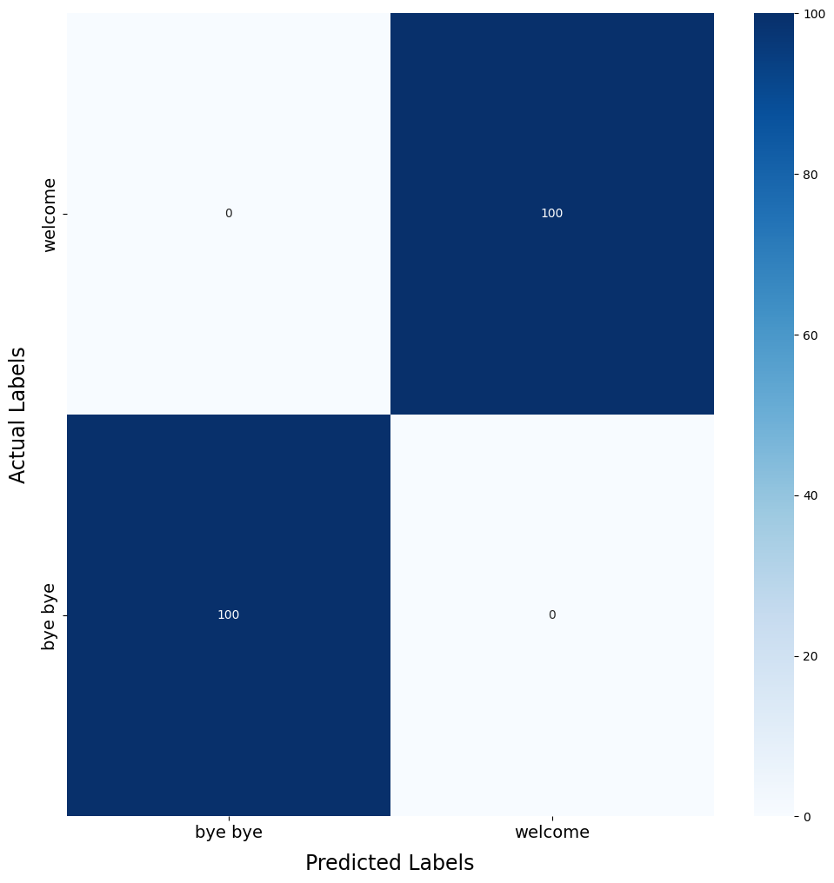
Confusion Matrix of the Trained Model

Slide 17
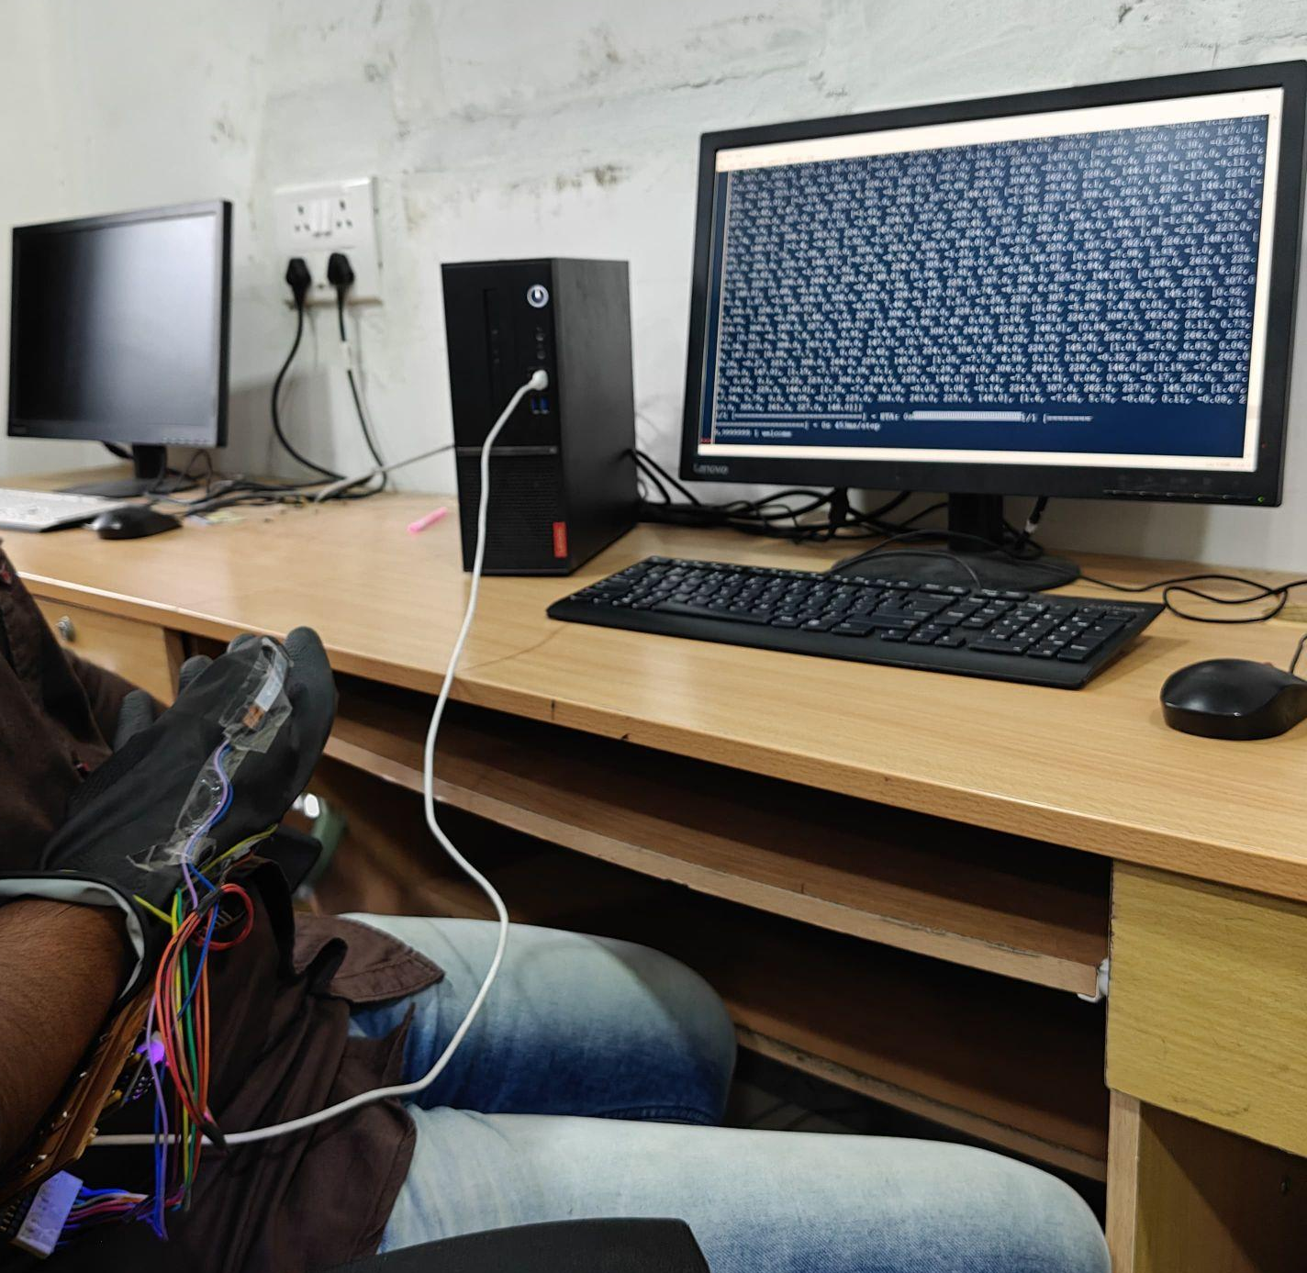
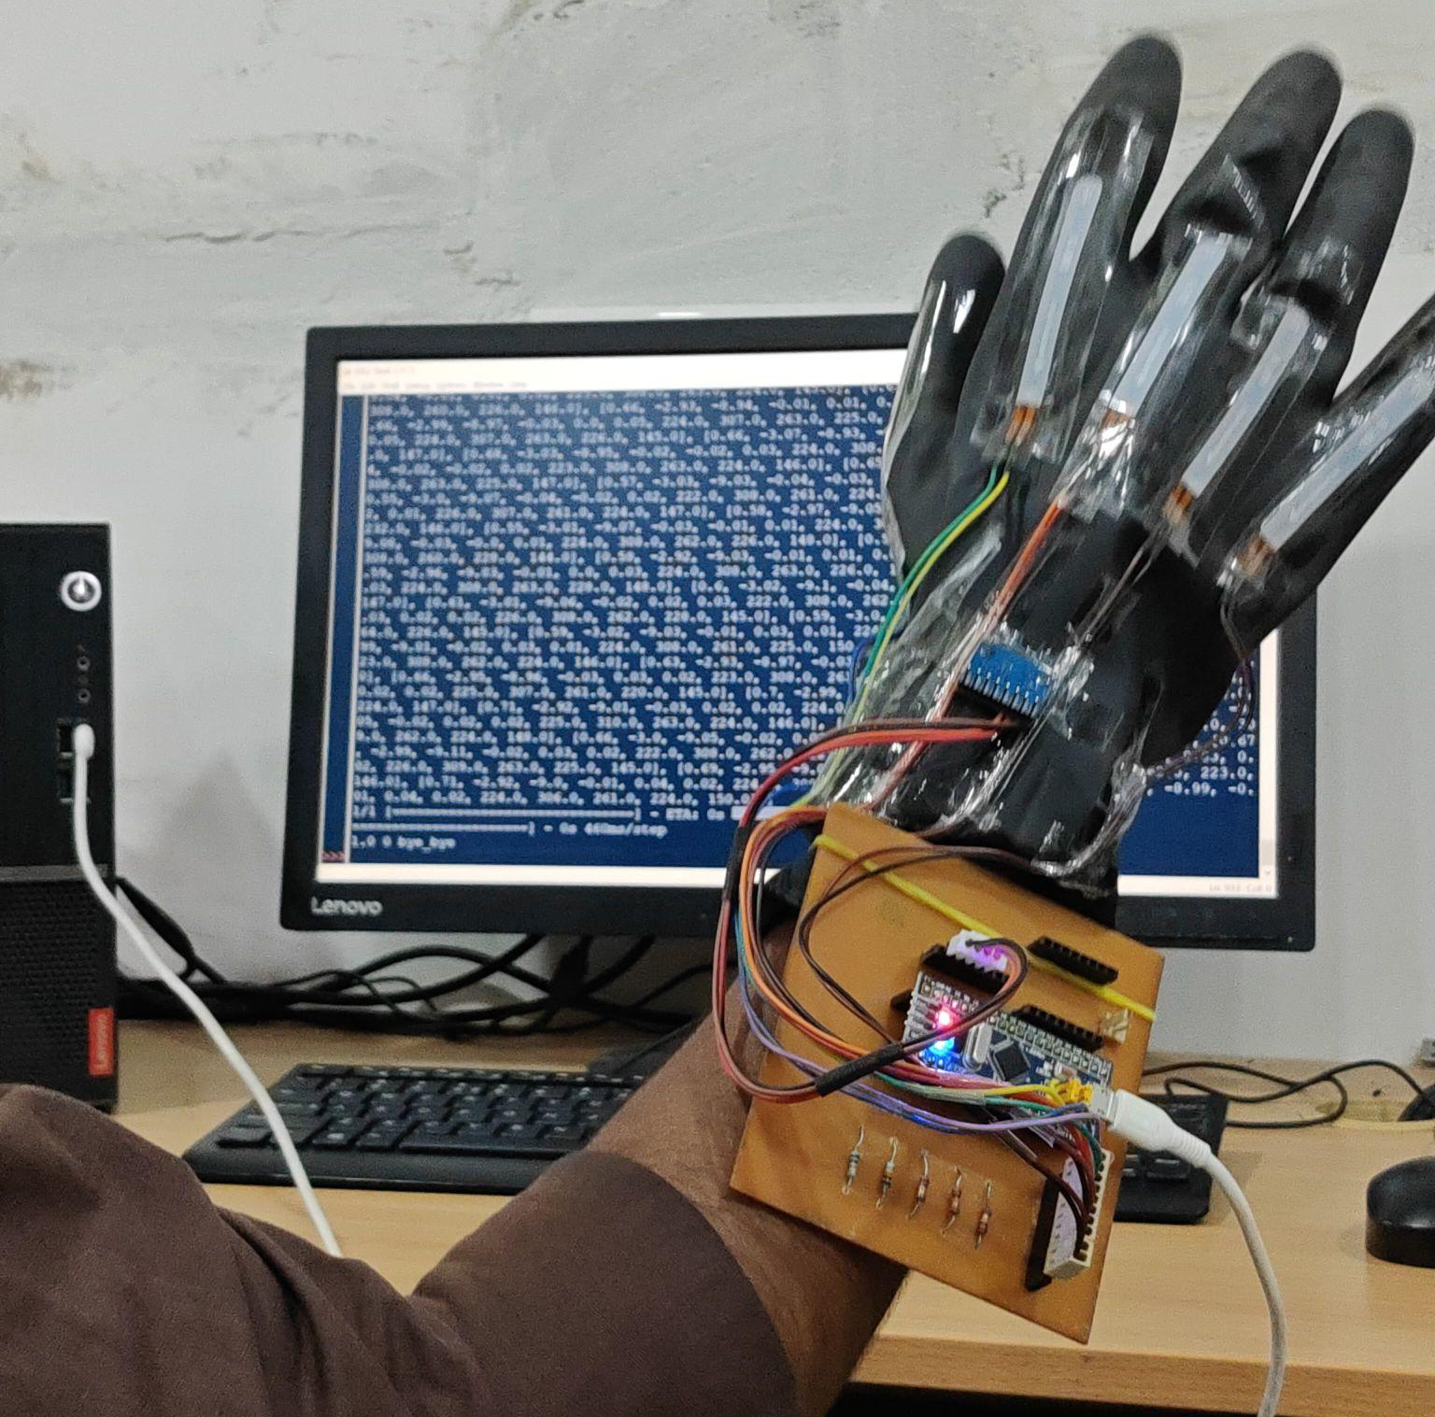
Real Time Testing of the trained Model

Slide 18
Conclusion
The designed system takes the real time data as input into the system
Data was collected for two signs and visualized for better understanding
A machine learning model has been trained using dataset and achieved 100% accuracy
The model is tested with real time data and able to distinguish between the two different signs
It gives accurate results when the model is tested with the person’s gesture whose gesture data has been collected and used for training
Overall, the designed system works efficiently for two sign gestures and to make it more prominent, more gestures can be collected from different sets of people

Slide 19
Thank You

